Slide 1
A Swarm Intelligence Algorithm For Routing Recovery Strategy In Wireless Sensor Network With Mobile Sink
Tom John
Class No: 62 S7 B Tech CSE
Dept. of CSE, MACE Kothamangalam
November 21
2018

Slide 2
CONTENTS
A swarm intelligence algorithm for routing recovery strategy in wireless sensor networks with mobile sink
Introduction
Existing systems
Drawbacks of existing system
Malware detection using CNN
PSO Algorithm
ABC Algorithm
ABC Optimized PSO Algorithm
Simulation,Comparison And Perfomance Analysis

Slide 3
INTRODUCTION
A swarm intelligence algorithm for routing recovery strategy in wireless sensor networks with mobile sink
Environment of wireless sensor network is unpredictable
Current methods are not having optimal transmission path.

Slide 4
EXISTING SYSTEMS
A swarm intelligence algorithm for routing recovery strategy in wireless sensor networks with mobile sink
Distributed multipath fault tolerance routing scheme
Hybrid energy efficient distributed clustering protocol
Bio inspired particle multi swarm optimization

Slide 5
DRAWBACKS OF EXISTING SYSTEMS
A swarm intelligence algorithm for routing recovery strategy in wireless sensor networks with mobile sink
Less stability
Reduced network performance
High network energy consumption
Less network robustness and reliability

Slide 6
PSO ALGORITHM
A swarm intelligence algorrithm for routing recovery strategy in wireless sensor networks with mobile sink
Simulate the foraging action of group of birds
Based on experience and cognition produced by foraging of food
There is only one piece of food in the area being searched
Birds know how far the food is
Birds follow the bird which is nearest to the food

Slide 7
PSO ALGORITHM
A swarm intelligence algorithm for routing recovery strategy in wireless sensor networks with mobile sink
All birds have a fitness value evaluated by the fitness function
‘pbest’ is the best value achieved so far by a particle
‘gbest’ is the best value obtained so far by any particle

Slide 8
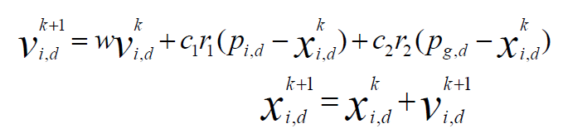
PSO ALGORITHM
A Swarm intelligence algorithm for routing recovery strategy in wireless sensor networks with mobile sink
c1,c2 - Recognition parameters
w - Inertia weight
P_{i} – Personal best value
P_{g} – Global best value

Slide 9
ARTIFICIAL BEE COLONY ALGORITHM
A Swarm intelligence algorithm for routing recovery strategy in wireless sensor networks with mobile sink
Three essential components of forage selection:
Food sources
Employed foragers
Unemployed foragers

Slide 10
EXCHANGE OF INFORMATION AMONG BEES
A Swarm intelligence algorithm for routing recovery strategy in wireless sensor networks with mobile sink
Most important occurrence in the formation of collective knowledge
Communication among bees takes place in the dancing area
The dance is called a Waggle dance
Employed forager share their information through waggle dancing

Slide 11
EXCHANGE OF INFORMATION AMONG BEES
A Swarm intelligence algorithm for routing recovery strategy in wireless sensor networks with mobile sink
Onlooker bee employ at the most profitable source
Greater probability of onlooker choosing more profitable sources
Scouts will discover new food sources
Poor food sources are ignored by bees

Slide 12
ABC ALGORITHM
A Swarm intelligence algorithm for routing recovery strategy in wireless sensor networks with mobile sink
Send the scouts onto the initial food sources
REPEAT
Send the employed bees onto the food sources and determine the nectar amounts
Calculate the probability value of the sources with which they are preferred by the onlooker bees
Send the onlooker bees onto the food sources and determine their nectar amounts
Stop the exploitation process of the sources exhausted by the bees
Send the scouts into the search area for discovering new food sources,randomly
Memorize the best food source found so far
UNTIL (requirements are met)

Slide 13
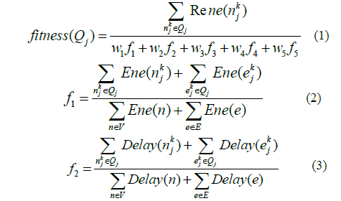
OPTMAL FITNESS VALUE
A swarm intelligence algorithm for routing recovery strategy in wireless sensor networks with mobile sink
Courtesy- IEEE paper on“A Swarm intelligence algorithm for routing recovery strategy in wireless sensor networks with mobile sink” from IEEE translations and content mining Published on March 2018

Slide 14
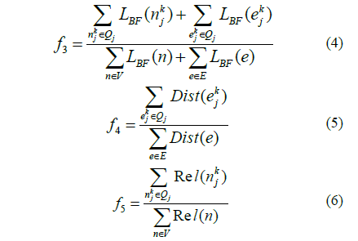
OPTIMAL FITNESS VALUE
A Swarm intelligence algorithm for routing recovery strategy in wireless sensor networks with mobile sink

Slide 15
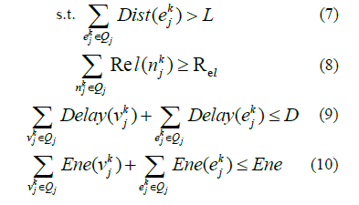
OPTIMAL FITNESS VALUE
A swarm intelligence algorithm for routing recovery strategy in wireless sensor networks with mobile sink

Slide 16
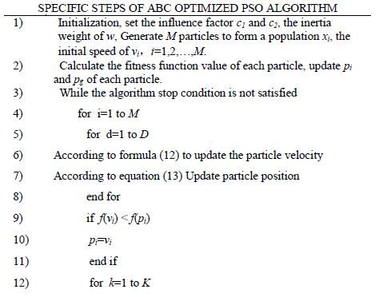
ABC OPTIMIZED PSO ALGORITHM
A swarm intelligence algorithm for routing recovery strategy in wireless sensor networks with mobile sink

Slide 17
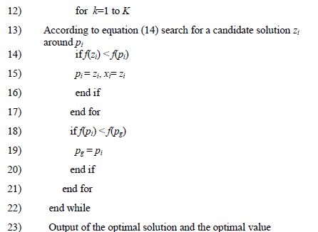
ABC OPTIMIZED PSO ALGORITHM
A swarm intelligence algorithm for routing recovery strategy in wireless sensor networks with mobile sink

Slide 18
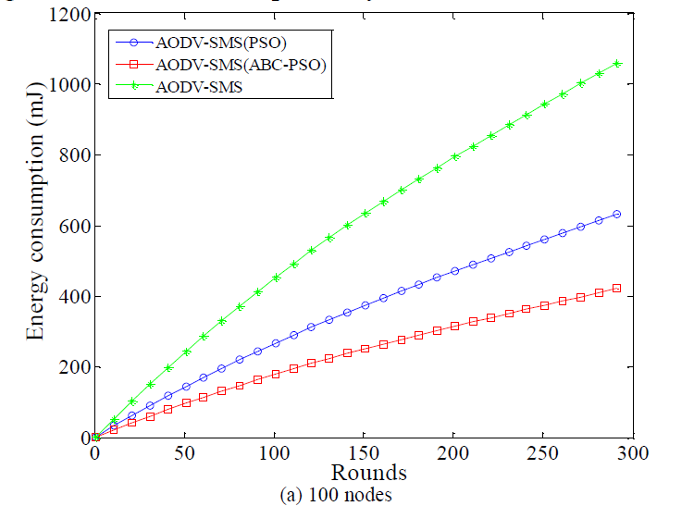
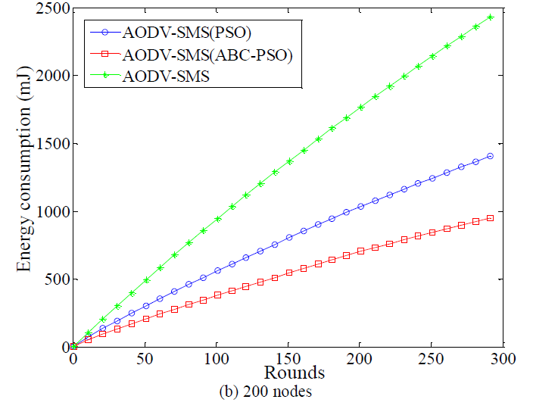
NETWORK ENERGY CONSUMPTION
A swarm intelligence algorithm for routing recovery strategy in wireless sensor networks with mobile sink
Courtesy- IEEE paper on “A Swarm intelligence algorithm for routing recovery strategy in wireless sensor networks with mobile sink” from IEEE translations and content mining Published on March 2018

Slide 19
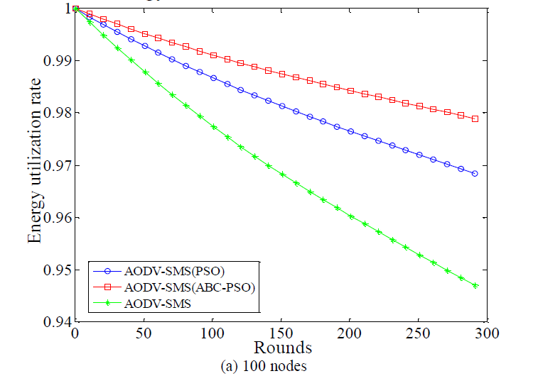
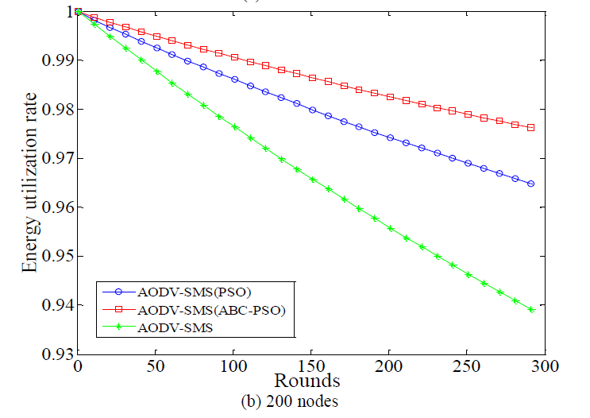
ENERGY UTILIZATION RATE
A swarm intelligence algorithm for routing recovery strategy in wireless sensor networks with mobile sink
Courtesy- IEEE paper on “A Swarm intelligence algorithm for routing recovery strategy in wireless sensor networks with mobile sink” from IEEE translations and content mining Published on March 2018

Slide 20
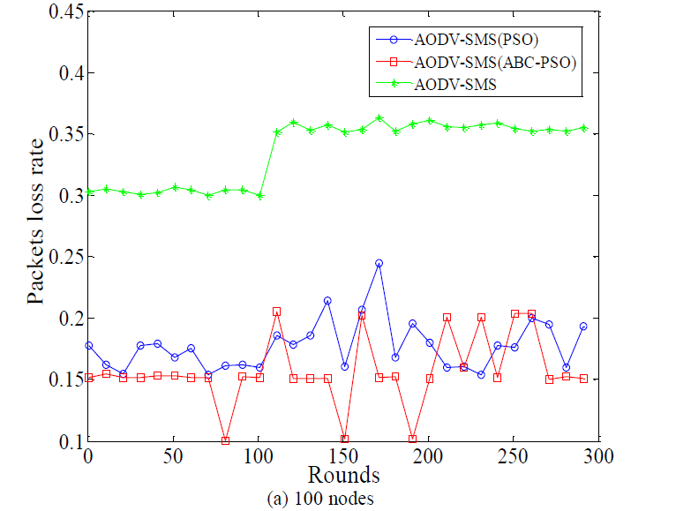
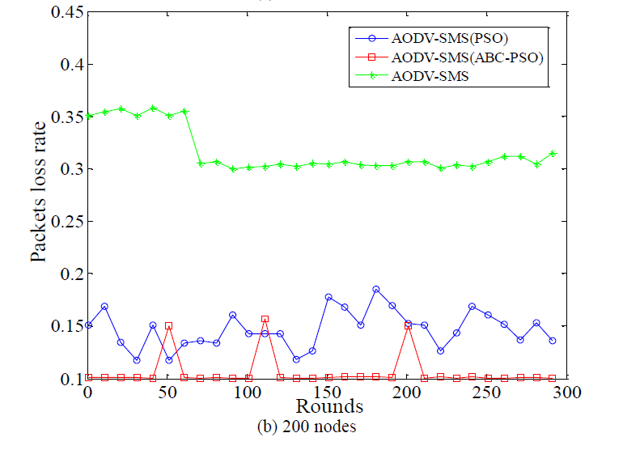
PACKET LOSS RATE
A swarm intelligence algorithm for routing recovery strategy in wireless sensor networks with mobile sink
Courtesy- IEEE paper on “A Swarm intelligence algorithm for routing recovery strategy in wireless sensor networks with mobile sink” from IEEE translations and content mining Published on March 2018

Slide 21
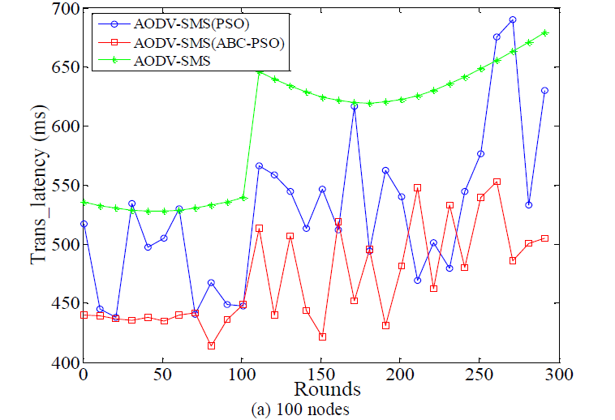
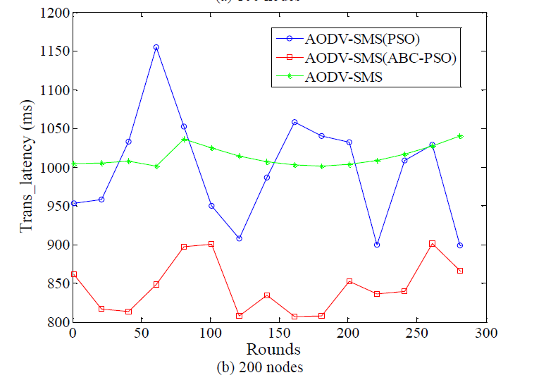
DATA TRANSMISSION LATENCY
A swarm intelligence algorithm for routing recovery strategy in wireless sensor networks with mobile sink
Courtesy- IEEE paper on “A Swarm intelligence algorithm for routing recovery strategy in wireless sensor networks with mobile sink” from IEEE translations and content mining Published on March 2018

Slide 22
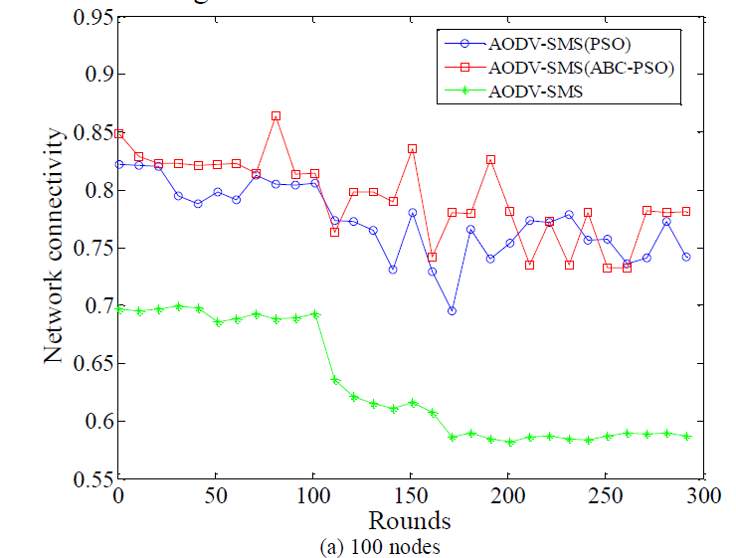
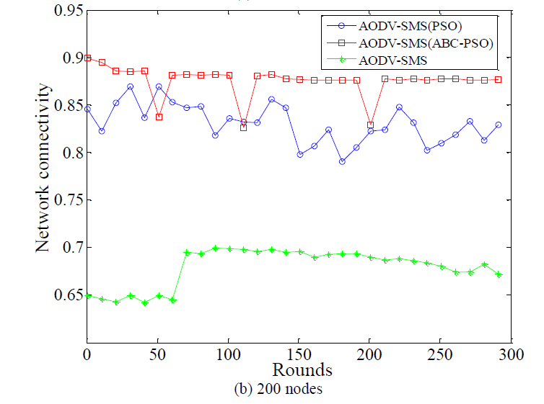
NETWORK CONNECTIVITY
A swarm intelligence algorithm for routing recovery strategy in wireless sensor networks with mobile sink
Courtesy- IEEE paper on “A Swarm intelligence algorithm for routing recovery strategy in wireless sensor networks with mobile sink” from IEEE translations and content mining Published on March 2018

Slide 23
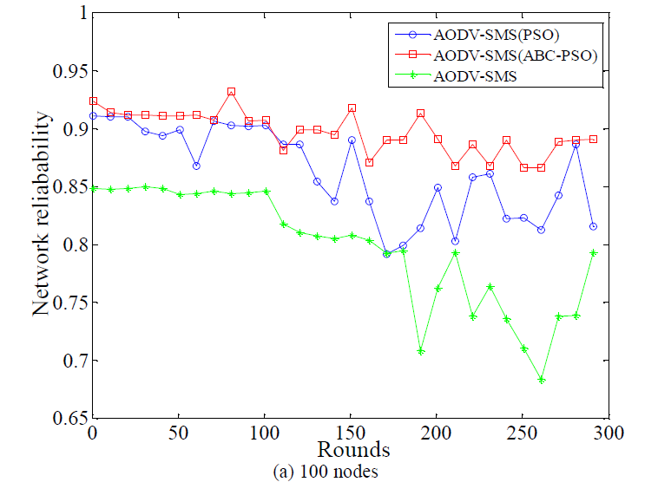
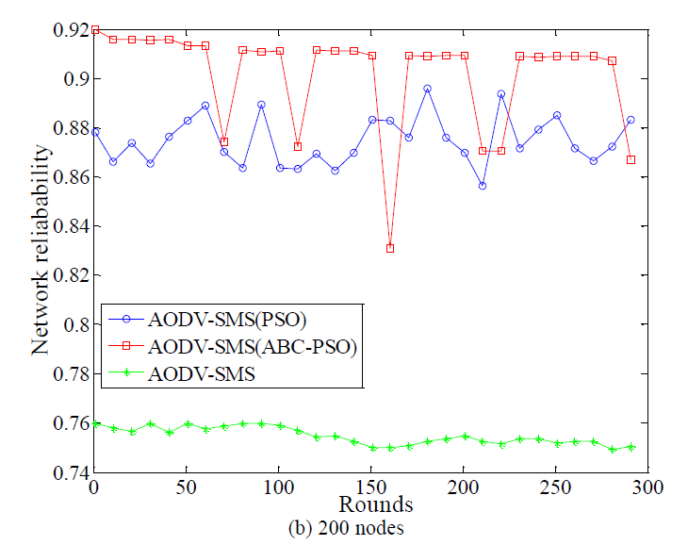
NETWORK RELIABILITY
A swarm intelligence algorithm for routing recovery strategy in wireless sensor networks with mobile sink
Courtesy- IEEE paper on “A Swarm intelligence algorithm for routing recovery strategy in wireless sensor networks with mobile sink” from IEEE translations and content mining Published on March 2018

Slide 24
CONCLUSION
Detection of Malicious Code Variants Based on Deep Learning
Images were identified and classified by a CNN.
That could extract the features of the malware images automatically.
Effectiveness and efficiency of this method is very high.
The detection speed of our model was significantly faster.

Slide 25
REFERENCES
Detection of Malicious Code Variants Based on Deep Learning
1.J. Wang, Y. Cao, B. Li, et al. Particle swarm optimization based clustering algorithm with mobile sink for WSNs. Future Generation Computer Systems, vol.11, no.76, pp. 452-457, 2017
2. Y. Yue, P. He. A comprehensive survey on the reliability of mobile wireless sensor networks: Taxonomy, challenges, and future directions. Information Fusion, vol.11, no.44, pp. 188-204, 2018
3.L. Karim, N Nasser. Reliable location aware routing protocol for mobile wireless sensor network,IET Communications, vol6, n0.14, pp.2149-2158,2012
4. X. Han, X. Cao, E.L.Lloyd. C. Shen. Fault-Tolerant Relay Node Placement in Heterogeneous Wireless Sensor Networks, IEEE Transactions on Mobile Computing, vol.9, no.5, pp.643-656, 2010
5. J. Wang, J. Cao, S. Ji, et al. Energy-efficient cluster-based dynamic routes adjustment approach for wireless sensor networks with mobile sinks. The Journal of Supercomputing, vol.73, no.7, pp. 3277-3290, 2017.
6. J. Wang, J. Cao, B. Li, et al. Bio-inspired ant colony optimization based clustering algorithm with mobile sinks for applications in consumer home automation networks. IEEE Transactions on Consumer Electronics, vol.61, no.4, pp. 438-444, 2015.

Slide 26
7. P. Li, H., Li, M. Wu. Distributed event region fault-tolerance based on weighted distance for wireless sensor networks, , Journal of Systems Engineering and Electronics, vol.20, no.6, pp.1351-1360, 2009
8.S. Bhatti, J. Xu, M. Memon. Clustering and fault tolerance for target tracking using wireless sensor networks, IET in Wireless Sensor Systems , vol.1, no.2, pp.66-73, 2011
9. Y. Sun, H. Luo, S.K. Das. A Trust-Based Framework for Fault-Tolerant Data Aggregation in Wireless Multimedia Sensor Networks, IEEE Transactions on Dependable and Secure Computing, vol.9, no.6, pp.785-797, 2012
10.H. Bagci, I. Korpeoglu, Yazıcı, A. A Distributed Fault-Tolerant Topology Control Algorithm for Heterogeneous Wireless Sensor Networks, IEEE Transactions on Parallel and Distributed Systems, vol.26, no.4, pp.914-923, 2015

Slide 27
THANK YOU

